Slide 1

SPRINKLER STATISTICS 2019 THE NORWEGIAN FIRE INDUSTRY ASSOCIATION (BTF)
A trade association for Norwegian manufacturers, importers, wholesalers, installers, controlling enterprises and service companies possessing relevant approvals of products and services in connection with firefighting equipment, engineering and installations

Slide 2
Sprinkler statistics 2019
Residential sprinklers: 189 330 down 34 487
Conventional Sprinklers: 611 990 down 32 390
Total down 66 877

Slide 3
SPRINKLERS

Slide 4
THE RATIO OF RESIDENTIAL AND CONVENTIONAL SPRINKLERs

Slide 5
Sprinkler statistics 2019
Watermist Residential:
21 432 up 2 413
Watermist:
7 781 down 148
Total up 2 265

Slide 6
WATERMIST
2013 BTF STARTED TO GATHER STATISTICS FOR WATERMIST

Slide 7
OVERALL

Slide 8
SALE OF WATERMIST INCREASED FROM 3 TO 4% OF THE WATER-BASED FIRE PROTECTION MARKET

Slide 9
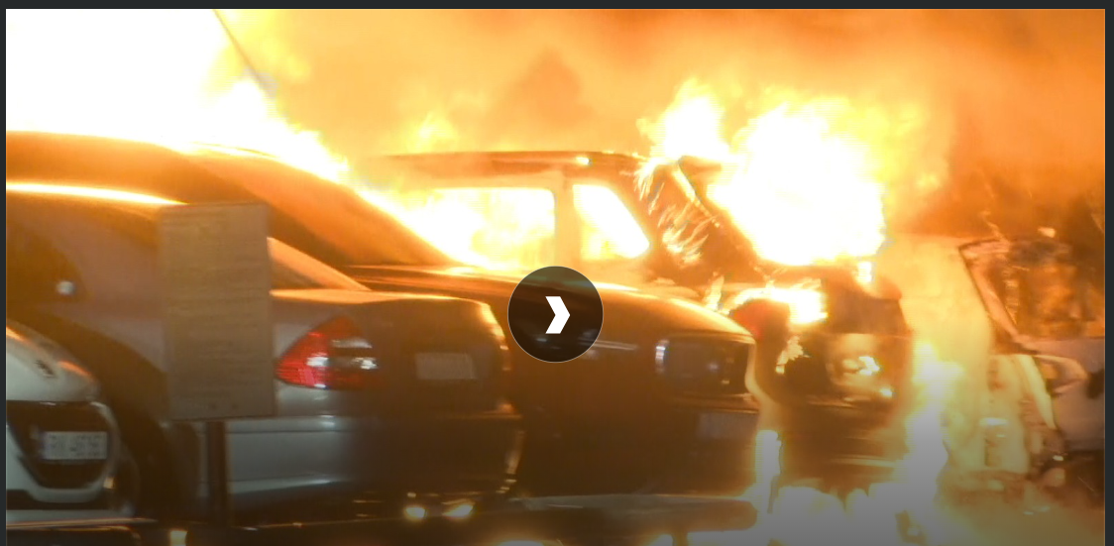
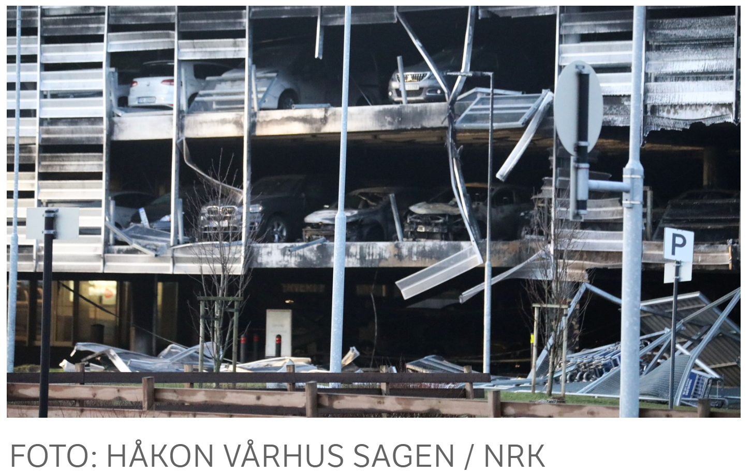
Stavanger Lufthavn february 2020
«- We fear the whole building will collapse. There are no sprinkler systems in the parking garage, so what is likely to happen is that it will burn on several floors. ”
“The insurance company for the owner of the car that started the big fire at Stavanger Airport pays NOK 2 million to the over 1,000 car owners who were hit by the fire, writes Aftenbladet”

Slide 10
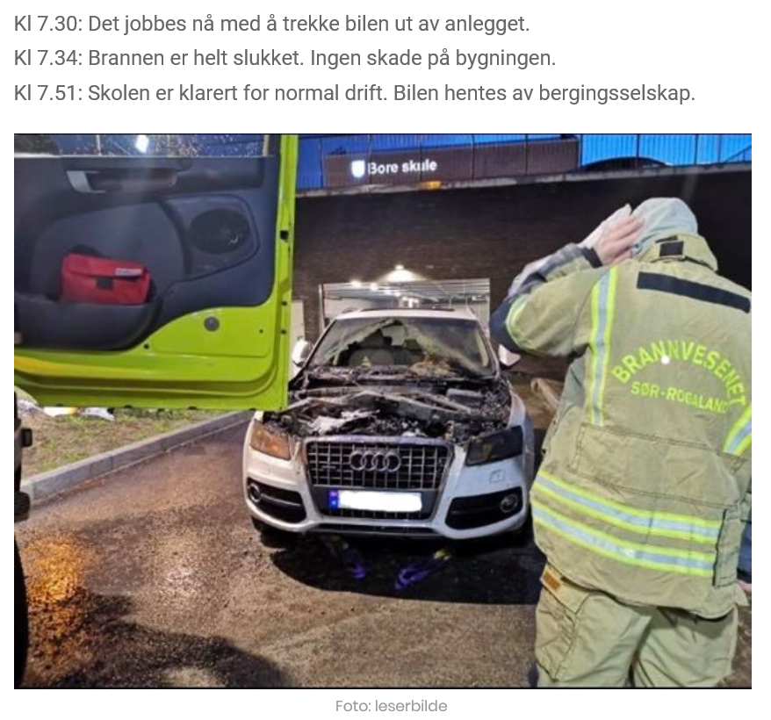
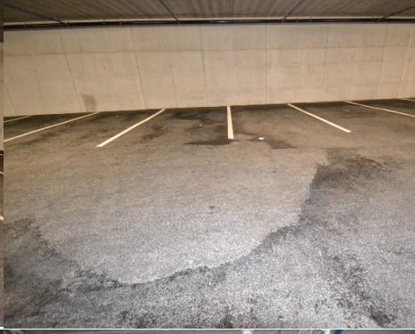
Fire at Bore Skule (School) 13. january 2020
All emergency services were quickly on the scene and started extinguishing. The garage is equipped with a sprinkler system, which was activated. According to the fire service, they had control of the fire before 7.30:
3 sprinkler heads activated

Slide 11
A big thank you to all the importers and suppliers who provide numbers to us for putting together the statistics every year

